Slide 1

ICT Learning Centre @ UL - Python and ML Foundations
ML - Regression

Slide 2

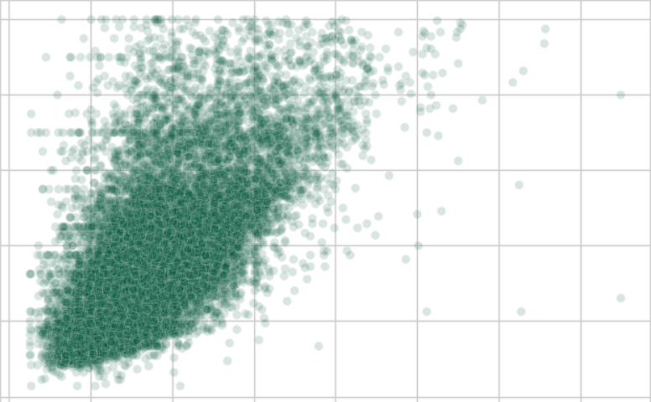
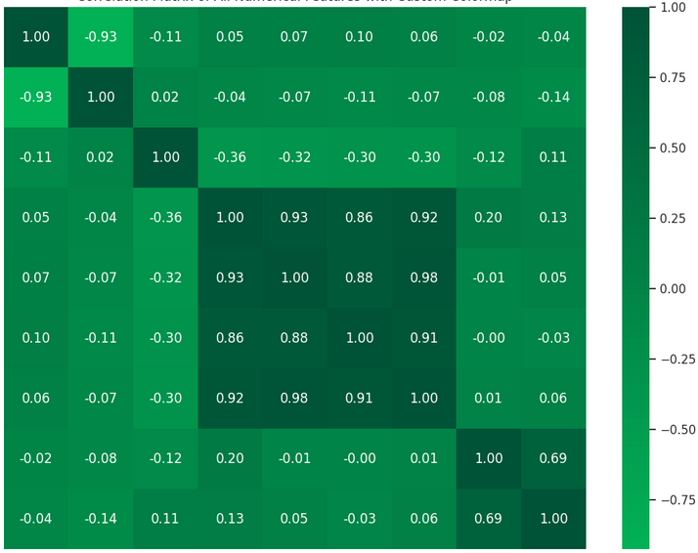
Where we left off…
California housing dataset
median_income – median_house_value

Slide 3


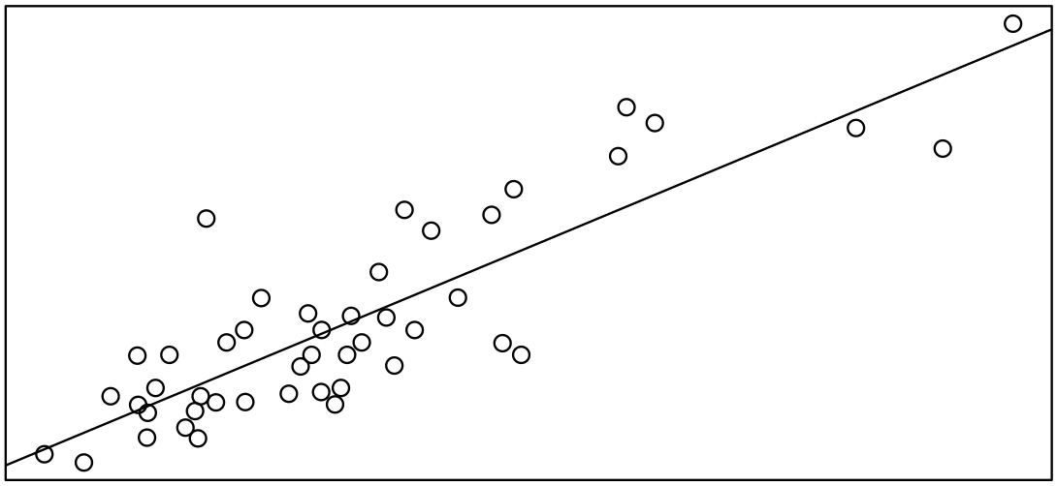
Regression
Predicting numbers

Slide 4
Supervised Learning: Recap

Slide 5












Supervised Learning
CAT
Uses labeled dataset
CAT
CAT
CAT
DOG
DOG
DOG
DOG
DOG

Slide 6
CAT
Supervised Learning
Uses labeled dataset
CAT
CAT
CAT
DOG
DOG
DOG
DOG
DOG

Slide 7

CAT
Supervised Learning
Uses labeled dataset
CAT
CAT
CAT
Model learns from data
DOG
DOG
DOG
DOG
DOG

Slide 8


Supervised Learning
Uses labeled dataset
CAT
Model learns from data
CAT
CAT
CAT
CAT
DOG
Model can predict label for unseen data
DOG
DOG
DOG
DOG

Slide 9
Supervised Learning
Model learns from ‘known’ data (labelled)
Makes predictions on unseen data
Supervised Learning
Continuous
Categorical
Regression
Classification

Slide 10

What is regression?
We try to find a single “best-fit” line that describes a pattern (from data).
y
x

Slide 11

Linear regression
^
Model learns
Model tries to find perfect slope, w and intercept, b for line.
y
x

Slide 12

How does it “learn”?
Model measures error or residual.

Slide 13

Mean Squared Error (MSE)
Loss function – measures total error.

Slide 14
Mean Squared Error (MSE)
Loss function – measures total error.

Slide 15
Mean Squared Error (MSE)
Loss function – measures total error.

Slide 16

Mean Squared Error (MSE)
Loss function – measures total error.
MSE

Slide 17

Mean Squared Error (MSE)
Loss function – measures total error.
MSE

Slide 18

Mean Squared Error (MSE)
Loss function – measures total error.
MSE

Slide 19

Mean Squared Error (MSE)
Loss function – measures total error.
Best fit line → lowest MSE
MSE

Slide 20

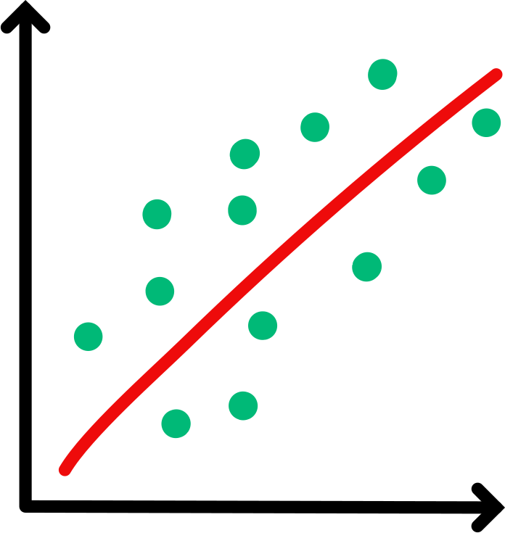


Scikit-learn

Slide 21
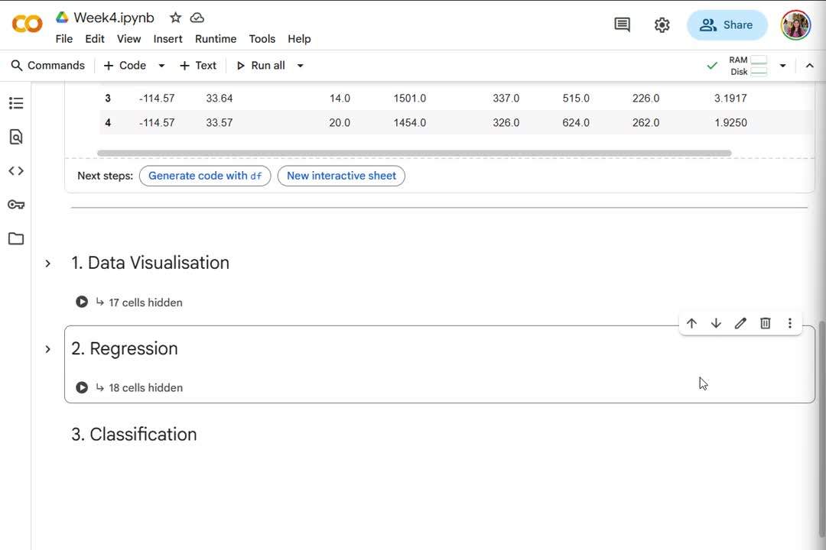

Slide 23

Train-Test Split
Need to split the data
To objectively test the model
Dataset
Training set
Testing set

Slide 24

Why split the data?
Model should not “memorise” data.
Model should generalise.
Avoid overfitting.
Dataset
Training set
Testing set

Slide 25
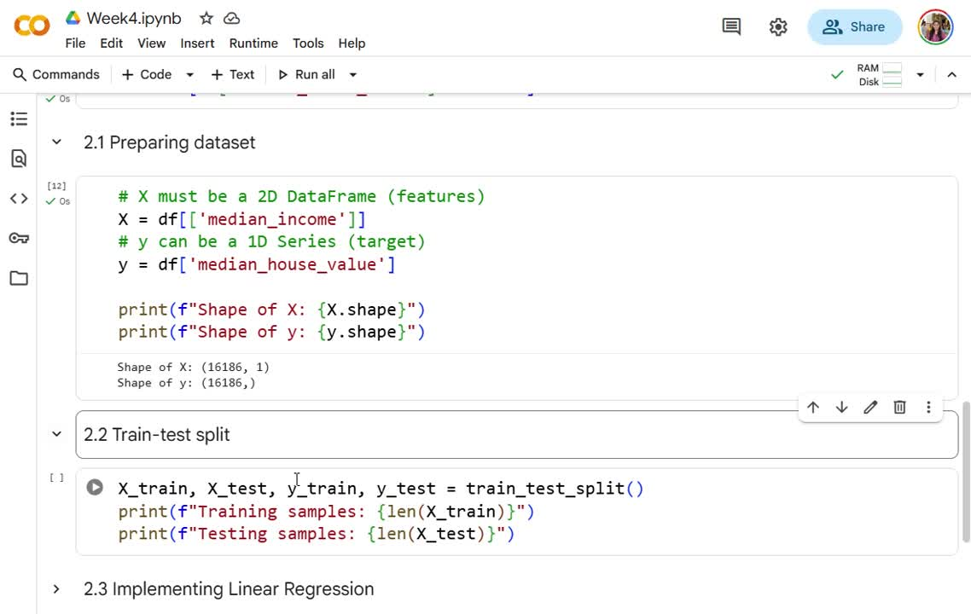

Slide 26
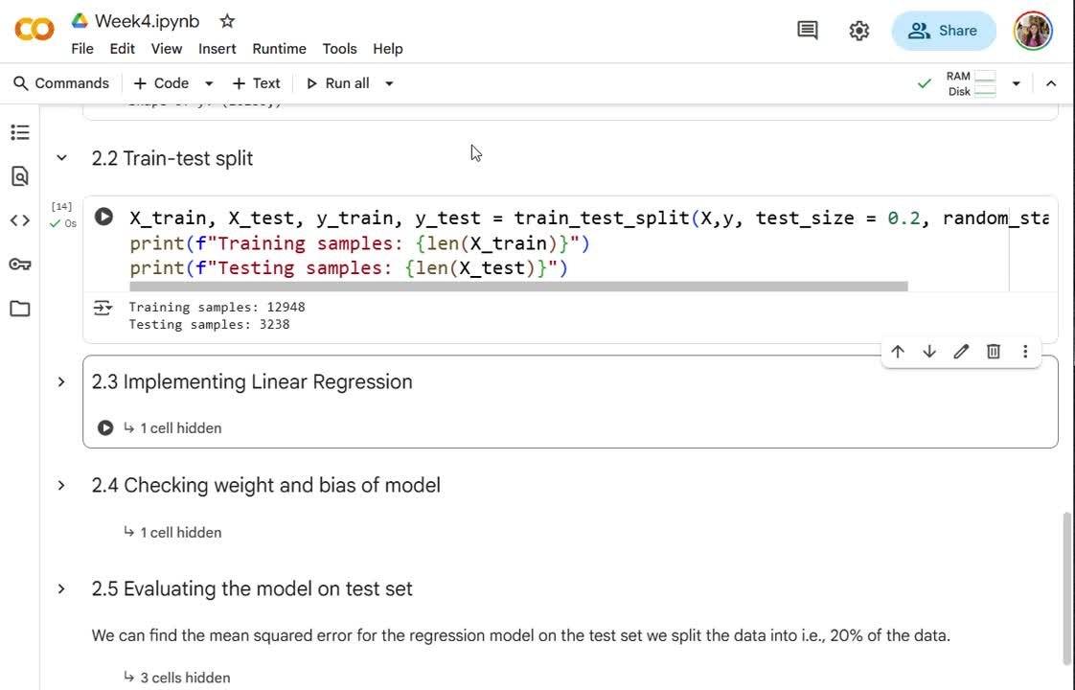

Slide 27
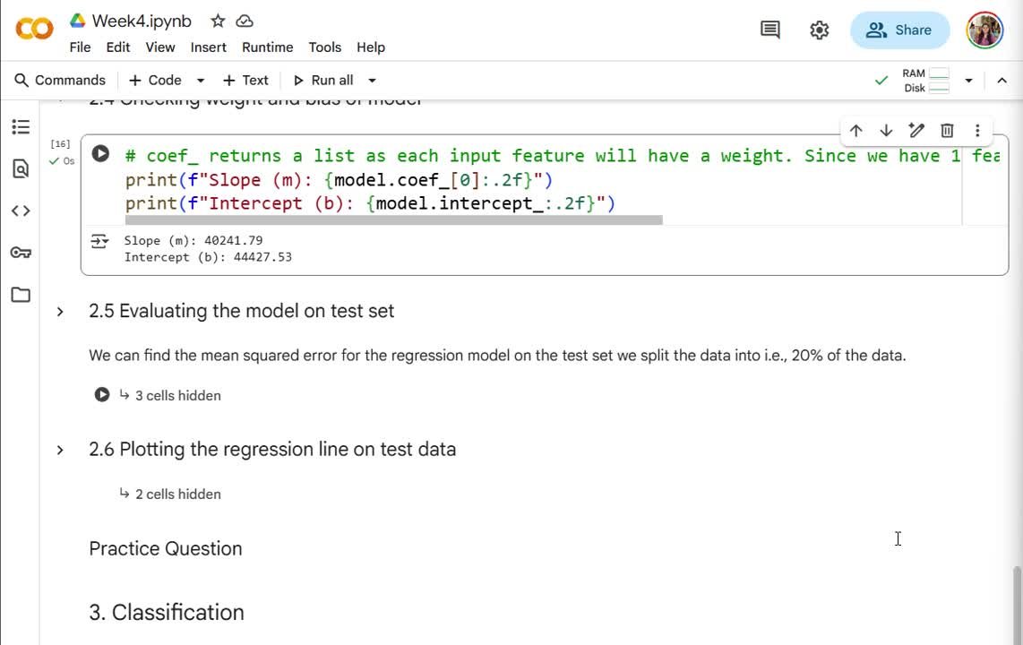
???

Slide 28
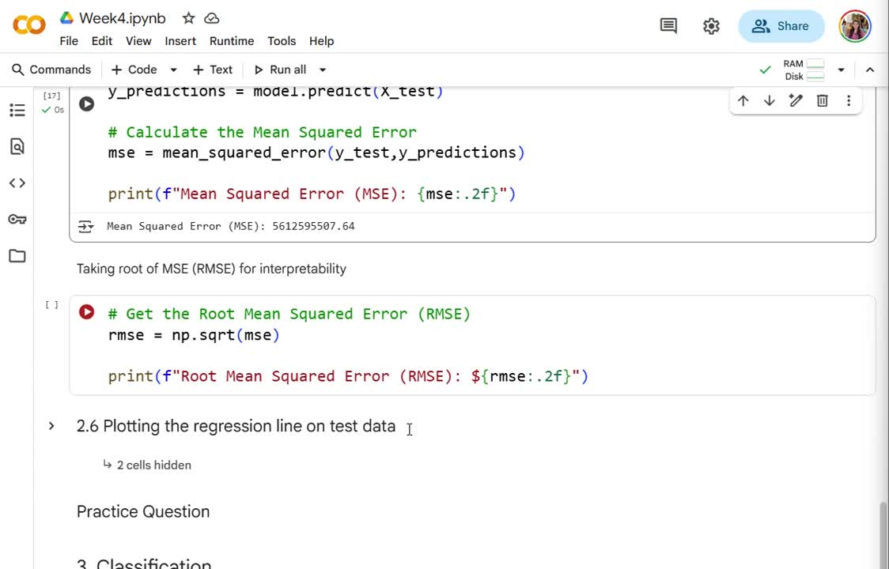

Slide 29

Practice Question
Artwork by @allison_horst

Slide 30
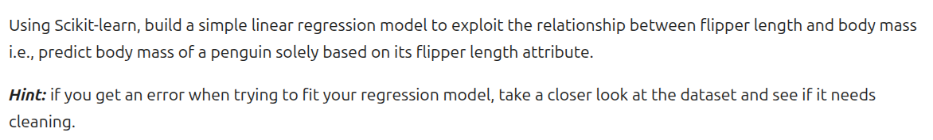
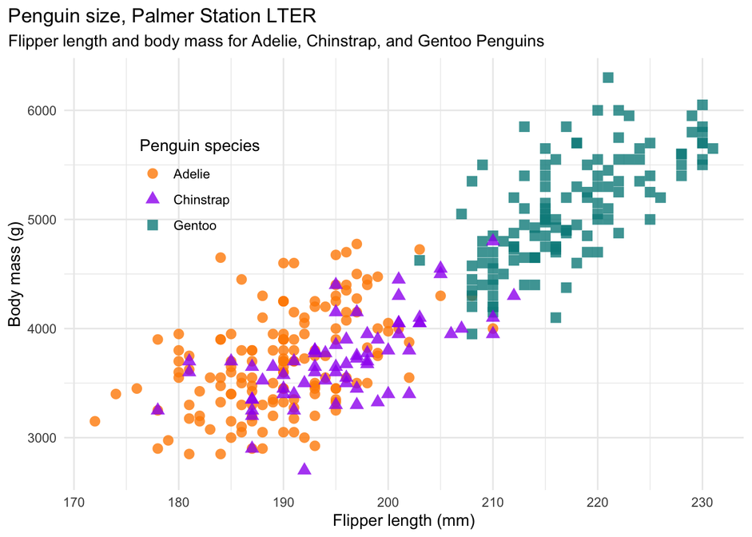
Practice Question
Artwork by @allison_horst

Slide 31

ICT Learning Centre,
CS1-046,
CSIS Building,
University of Limerick,
http://ictlc.ul.ie/contactus
Thank you

